Slide 1
Numerical integration

Slide 2
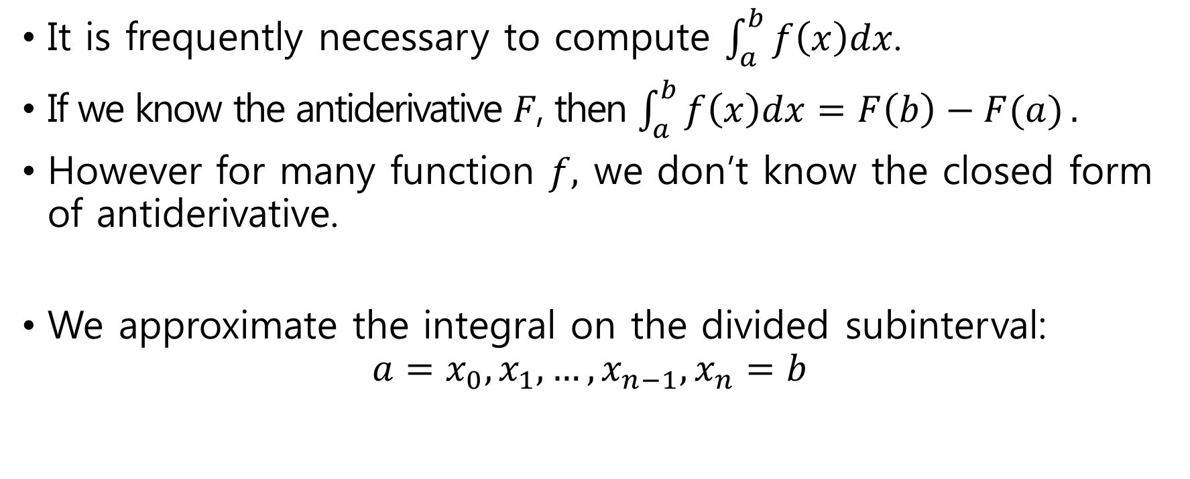
Numerical integration
It is frequently necessary to compute $\int_{a}^{b}{f\left(x\right)dx}$.
If we know the antiderivative $F$, then $\int_{a}^{b}{f\left(x\right)dx=F\left(b\right)−F(a)}.$
However for many function $f,$ we don’t know the closed form of antiderivative.
We approximate the integral on the divided subinterval: $a=x_{0},x_{1},…,x_{n−1},x_{n}=b$

Slide 3
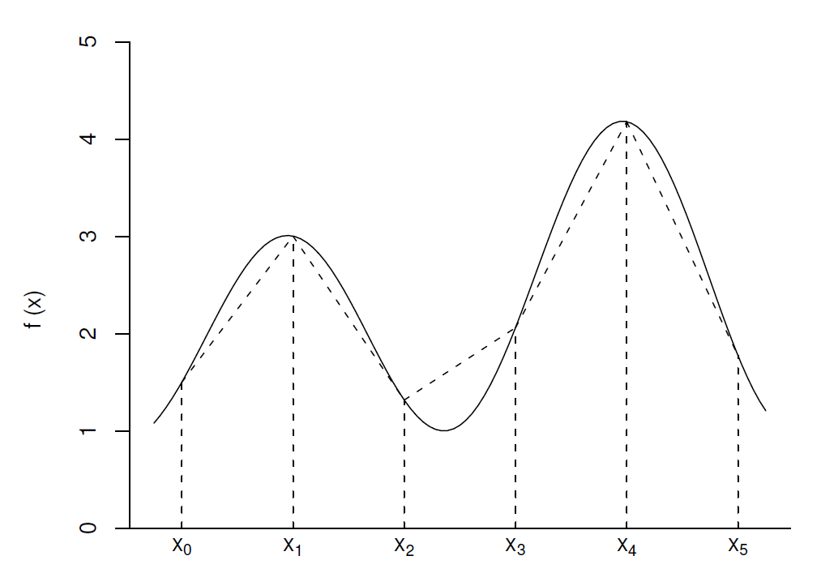
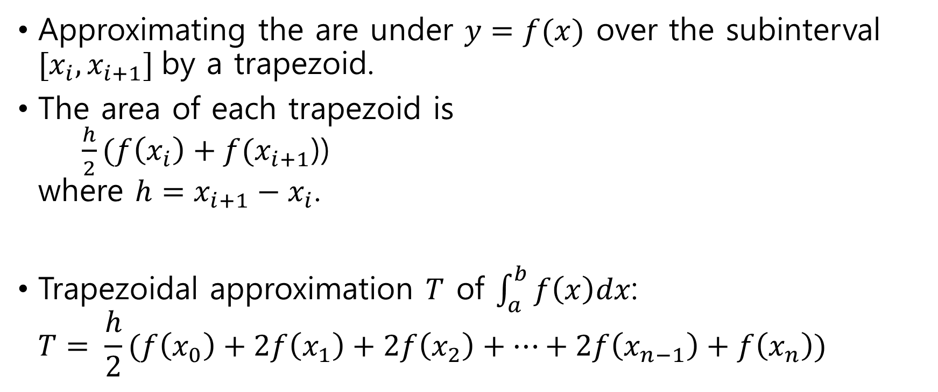
Trapezoidal rule
Approximating the are under $y=f(x)$ over the subinterval $[x_{i}, x_{i+1}]$by a trapezoid.
The area of each trapezoid is $\frac{h}{2}(f\left(x_{i}\right)+f(x_{i+1}$)) where $h=x_{i+1}−x_{i}$.
Trapezoidal approximation $T$ of $\int_{a}^{b}{f\left(x\right)dx}$: $T= \frac{h}{2}(f\left(x_{0}\right)+2f\left(x_{1}\right)+2f\left(x_{2}\right)+⋯+2f\left(x_{n−1}\right)+f\left(x_{n}\right))$

Slide 4
R code for trapezoid
trapezoid <- function(ftn, a, b, n = 100) {
h <- (b-a)/n
x.vec <- seq(a, b, by = h)
f.vec <- sapply(x.vec, ftn)
T <- h*(f.vec[1]/2 + sum(f.vec[2:n]) + f.vec[n+1]/2)
return(T)
}
> ftn6 <- function(x) return(4*x^3)
> trapezoid(ftn6, 0, 1, n=20)
[1] 1.0025
> trapezoid(ftn6, 0, 1, n=40)
[1] 1.000625

Slide 5
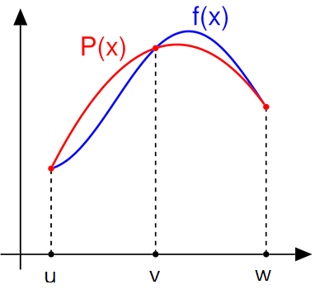
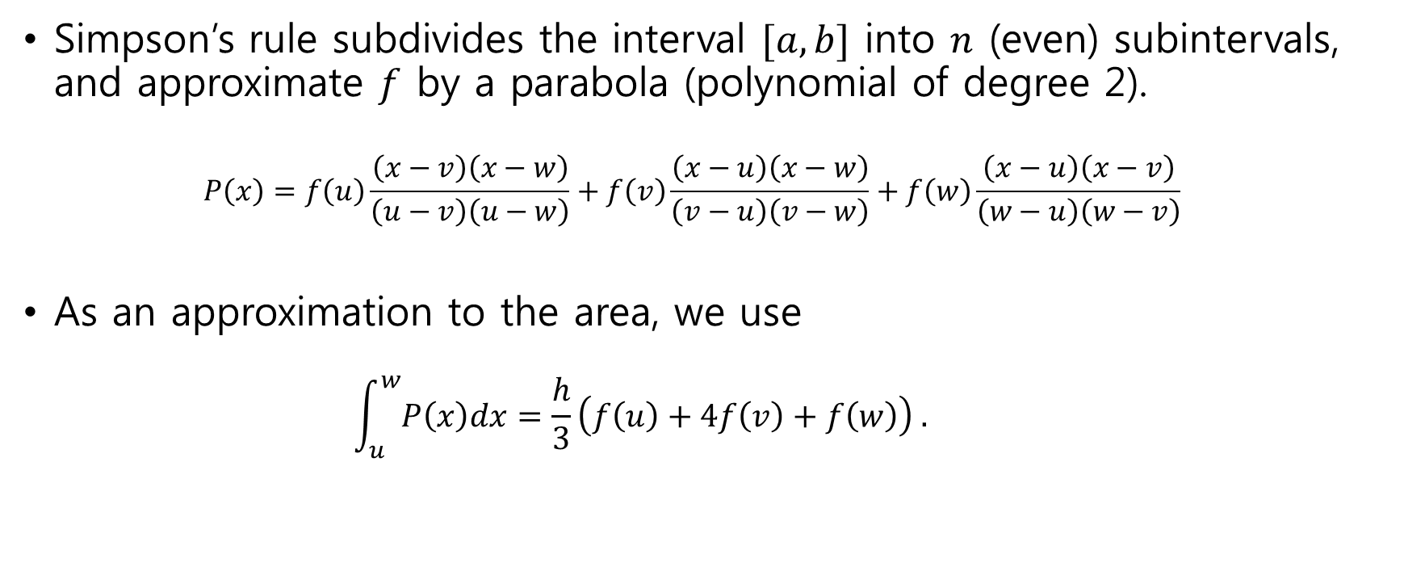
Simpson’s rule
Simpson’s rule subdivides the interval $[a,b]$ into $n$ (even) subintervals, and approximate $f$ by a parabola (polynomial of degree 2). $P\left(x\right)=f\left(u\right)\frac{\left(x−v\right)\left(x−w\right)}{\left(u−v\right)\left(u−w\right)}+f\left(v\right)\frac{\left(x−u\right)\left(x−w\right)}{\left(v−u\right)\left(v−w\right)}+f\left(w\right)\frac{\left(x−u\right)\left(x−v\right)}{\left(w−u\right)\left(w−v\right)}$
As an approximation to the area, we use $\int_{u}^{w}{P\left(x\right)dx}=\frac{h}{3}\left(f\left(u\right)+4f\left(v\right)+f\left(w\right)\right) .$

Slide 6
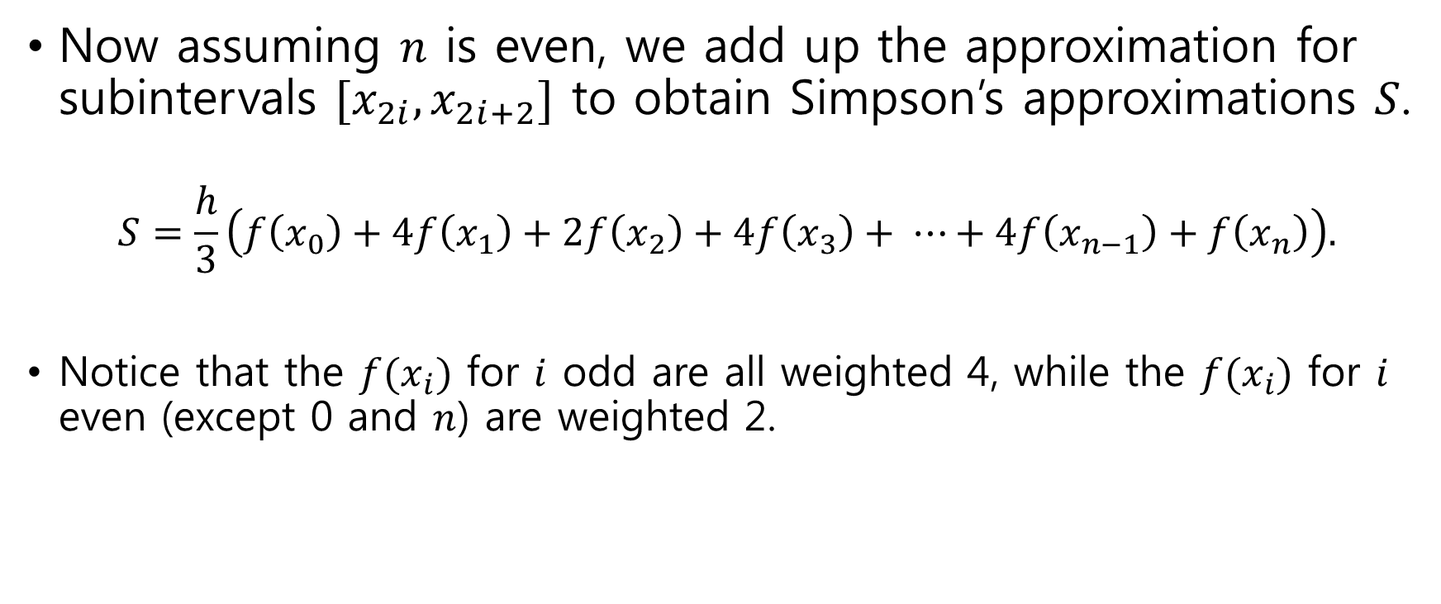
Simpson’s rule (2)
Now assuming $n$ is even, we add up the approximation for subintervals $[x_{2i},x_{2i+2}]$ to obtain Simpson’s approximations $S$.
$$S=\frac{h}{3}\left(f\left(x_{0}\right)+4f\left(x_{1}\right)+2f\left(x_{2}\right)+4f\left(x_{3}\right)+ ⋯+4f\left(x_{n−1}\right)+f\left(x_{n}\right)\right).$$
Notice that the $f(x_{i})$ for $i$ odd are all weighted 4, while the $f(x_{i})$ for $i$ even (except 0 and $n$) are weighted 2.

Slide 7
R code for Simpson’s rule
simpson_n <- function(ftn, a, b, n = 100) {
n <- max(c(2*(n %/% 2), 4))
h <- (b-a)/n
x.vec1 <- seq(a+h, b-h, by = 2*h)
x.vec2 <- seq(a+2*h, b-2*h, by = 2*h)
f.vec1 <- sapply(x.vec1, ftn)
f.vec2 <- sapply(x.vec2, ftn)
S <- h/3*(ftn(a) + ftn(b) + 4*sum(f.vec1) + 2*sum(f.vec2))
return(S)
}
> ftn6 <- function(x) return(4*x^3)
> simpson_n(ftn6, 0, 1, 20)
[1] 1

Slide 8
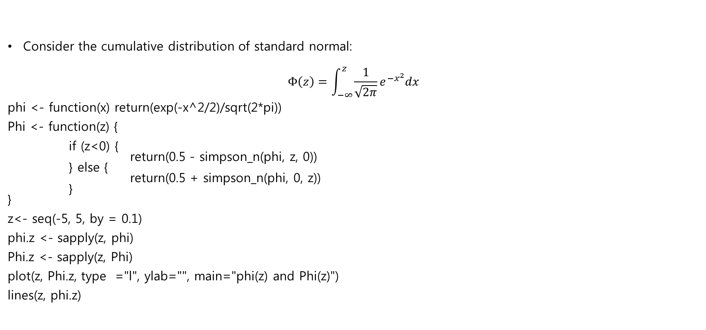

Example : $Φ(z)$
Consider the cumulative distribution of standard normal:
$$Φ\left(z\right)=\int_{−∞}^{z}{\frac{1}{\sqrt{2π}}e^{{−x}^{2}}dx}$$
phi <- function(x) return(exp(-x^2/2)/sqrt(2*pi))
Phi <- function(z) {
if (z<0) { return(0.5 - simpson_n(phi, z, 0)) } else { return(0.5 + simpson_n(phi, 0, z)) } }
z<- seq(-5, 5, by = 0.1)
phi.z <- sapply(z, phi)
Phi.z <- sapply(z, Phi)
plot(z, Phi.z, type ="l", ylab="", main="phi(z) and Phi(z)")
lines(z, phi.z)

